Slide 1
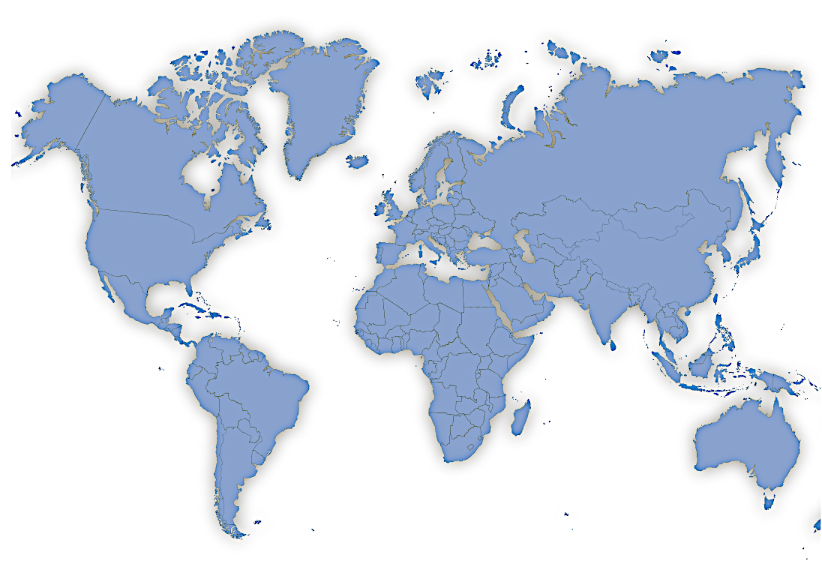
Predicting the success of cyber-related Terrorist Attacks
Using the Global Terrorism Database provided by START at the University of Maryland:
http://www.start.umd.edu/gtd/
Citation: National Consortium For The Study Of Terrorism And Responses To Terrorism (Start). (2018). Global Terrorism Database [Data File]. Retrieved From Https://Www.Start.Umd.Edu/Gtd

Slide 2



Research Questions and Objectives
What characterizes a
successful cyber attack?
Who can benefit from
any resulting information?
Government/Intelligence Agencies, Citizens, Operatives:
Safety:
Prevent attacks; save lives.
Identify realistic threats with precision.
Reduce lingering consequences of attacks (infrastructure, communication, health and public welfare issues).
Understanding:
Sharpen knowledge and accuracy regarding known and lesser-known terrorist groups, their operating territories and targets.
Locate previously overlooked potential targets
Increase ability to identify new/previously-unseen areas of threat.
Efficiency:
Decrease mis-direction of labor, energy and assets
Increase effectiveness and efficiency of resources on more realistic threats.

Slide 3
Background:
Hosted by the University of Maryland and funded by the US Department of State (until May 2018).
What incidents qualify for this database?:
- “For an event to be included in the GTD, the attackers must be ‘out the door,’ enroute to execute the attack. Planning, reconnaissance, and acquiring supplies do not meet this threshold.” p. 11 Codebook.
What is a terrorist attack?
Page 10 of the Codebook lists that a terrorist attack must include the following characteristics: intention, violence and non-state-related perpetrators (i.e. those outside of the current government).
Regarding our output feature ‘Success’:
An attack is classified as successful if noticeable consequences occur as a result of the attack.
“The definition of a successful attack depends on the type of attack. Essentially, the key question is whether or not the attack type took place.” p. 26 Codebook.
Potential issues given the nature of this data:
Given that there are instances of terrorism which do not necessarily reach an ‘enacted’ state (according to this database), further researchers/people using this database (including these results) must be careful and recognize that a plethora of other instances (nearly-executed plans that went un-noticed, etc.) can and should be included for consideration when possible.

Slide 4
Location Features:
What characterizes a
successful cyber attack?
Feature Name | Description | Object Type | Most Frequent Value or/Mean
country_txt | Country | Object | India
region_txt | Region | Object | South Asia
city | City | Object | Unknown
target_1txt | Broad target description. | Object | Private Citizens and Property
sub_targettxt | More detailed target info. | Object | Police Security Forces/Officers
corp1 | Identification of targeted corporation (if applicable). | Object | ‘Not Applicable’
specific_target | Specific target info (if applicable). | Object | Civilians
victim_nationalitytxt | Victim nationality. | Object | India
property | Was there property damage? | Int64 | -.937
What is our output feature?
Our output feature will be the success column. In other words, this will be the information we are trying to predict. Given that we are building models to try and predict this information, we will use this column to compare our model predictions to some actual results and ascertain its accuracy before applying it to newer information (where we do not have information on the attack’s success yet).
Other features:
This data-set consists of numerous features. In order to stay within the time-frame of this project, we will limit our analysis to some of the more prominent and easily recognized/comprehensible features.
This selection of features could lend itself to bias and should not be considered definitive. The use of Select K-Best and PCA algorithms below will aim to reduce some of this bias.

Slide 5
Attack Features:
Feature Names | Description | Object Type | Most Frequent Value/Mean
crit1 | “Political, Economic, Religious or Social Goal?” | Int64 / Binary | .988
crit2 | “Intention to coerce, intimidate or publicize to larger audience(s)?” | Int64 / Binary | .987
crit3 | “Outside international humanitarian law?” | Int64 / Binary | .948
doubt | Is there doubt regarding classifying the attack as terrorism? | Float64 / Binary | -.047
suicide | Was the attack a suicide attack? | Int64 / Binary | .040
attack_1txt | Means of attack. | Object | Bombing/Explosion
group_name | Name of perpetrating terrorist group. | Object | Unknown
group_attrib_certainty | Is group-attribution dubious? | Float64 / Binary | .190
unaffil_individ | Was perpetrator identified by name and acting as an individual? | Int64 / Binary | .005
weapon_txt | Type of weapon. | Object | Explosives
sub_weapontxt | More detailed weapon info. | Object | Unknown Gun Type
motive | Motive of attack |  | n/a
summary | Synopsis of attack. | Object | n/a
success | Was the attack successful? | Int64 / Binary | .904
Regarding our output feature ‘Success’:
An attack is classified as successful if noticeable consequences occur as a result of the attack. (p. 26 Codebook).
“The definition of a successful attack depends on the type of attack. Essentially, the key question is whether or not the attack type took place.” p. 26 Codebook.

Slide 6


Workflow
Data Pre-Processing
Exploratory Analysis
Preliminary Models
Feature Engineering
Data Wrangling
Parameter Tuning

Slide 7
Data Pre-Processing:
Sifting out Cyber-Related Data:
Splitting Train/Test Data:
Removing Null
Values:
Selecting Primary Features:
Value-Filtering:
Database is vast and multi-faceted.
Prevents over-fitting
Not a big problem after using our Regex Filter.
Focus on understandable and actionable features
Prepares data for later modeling
Method: Regex
Provides realistic and reliable scoring
Primarily focused on replacing values with ‘Unknown’
Most translatable across potential audiences
Condenses values for feature-selection algorithm
Issues: Regex function might not catch all instances - decreasing accuracy
Produces safer models for implementation
Did not have to drop too many values completely.
Numerically significant (i.e. no human-assigned numeric categorizations).
Keeps data comprehensible for humans while maintaining flexibility for machines/computers
Data Pre-Processing
Exploratory Analysis
Feature Engineering
Data Wrangling
Preliminary Models
Parameter Tuning

Slide 8

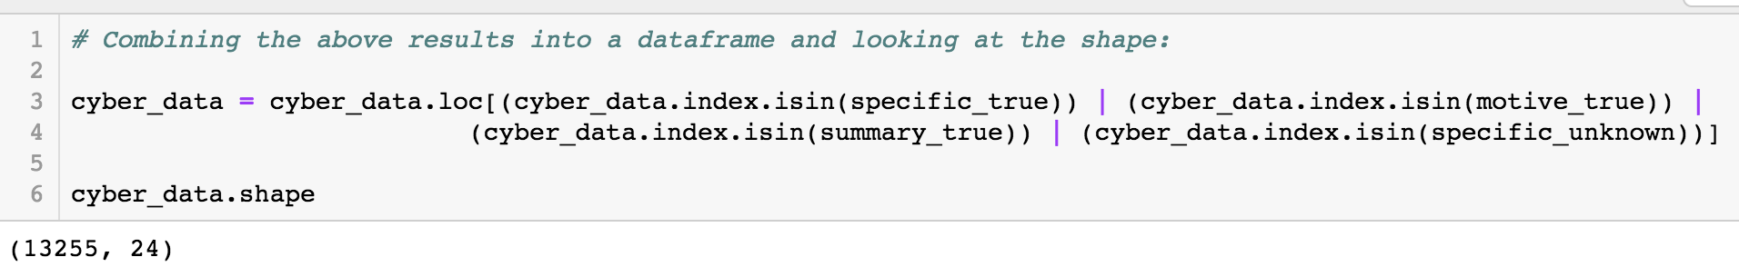
Data Pre-Processing:
Detailed Workflow:
Sifting out Cyber-Related Data:
Database is vast and multi-faceted (too large).
Filter allows us to focus on cyber-instances.
Method: Regex
Features: motive, summary and specific_target.
Issues: Regex function might not catch all instances - decreasing accuracy.
Data Variable: ‘cyber-data’
Workflow Stage: Pre-Processing
Sub-Stage: Filtered for Cyber-Instances
Size: 13255 Observations x 24 Features
Issues: Could also incorporate instances that are realistically unrelated.

Slide 9
Data Pre-Processing:
Splitting Train/Test Data:
Detailed Workflow:
Prevents over-fitting.
Provides realistic and reliable scoring.
Produces safer models for implementation.
Leakage Prevention: Split before further manipulation to maintain data-integrity.
- i.e.: Any groupings/null-removals, etc. will be contained within each subset of data. This prevents data removal from leaving traces of its removal in another subset.
Data Variable: ‘X_train/X_test/Y_train/Y_test’
Workflow Stage: Pre-Processing
Sub-Stage: Splitting training/test sets.
Train-Size: 9941/3314 Observations x 20 Features

Slide 10
Data Pre-Processing:
Detailed Workflow:
Select comprehensible text features:
Replacing Null
Values:
Selecting Primary Features:
Not a big problem after using our Regex Filter.
Focus on understandable and actionable features.
Primarily focused on replacing values in text columns with ‘Unknown’:
This maintains the rest of the row’s information in the dataset without providing misleading information (such as an n/a or ‘0’ value) for this specific column
Fill object columns with ‘Unknown.’
Most translatable across potential audiences.
Drop numeric nulls just before modeling.
Numerically significant (i.e. no human-assigned numeric categorizations).
Only numeric column was group_attrib_certainty.
This was a very low number. Dropping these values before modeling will still maintain data integrity.
Data Variable: ‘cyber_train/test_X, cyber_train/test_Y ’
Workflow Stage: Pre-Processing
Sub-Stage: Replacing nulls and selecting meaningful features.
Size: 9941/3314 Observations x 19 Features

Slide 11
Data Pre-Processing:
Value-Filtering:
Prepares data for later modeling.
sub_targettxt:
Condenses values for feature-selection algorithm.
specific_target:
Keeps data comprehensible for humans while maintaining flexibility for machines/computers.
Method: Pandas .replace()
group_name:
Features: city, group_name, specific_target, sub_target
Issues:
Not safe from human bias.
Highly dependent on careful research.
city:

Slide 12
Exploratory Analysis:
Class Imbalance:
Can lead to a warped perspective:
Lots of information about successful attacks.
Not enough information on unsuccessful attacks.
Keeping an eye on our false positive predictions will be necessary. Most of our predictions will be positive. Limiting our incorrectly negative predictions will tell us how strong our model is.
Exploratory Analysis
Using a balanced accuracy score will help our evaluations take class imbalance into account.
Data Pre-Processing
Preliminary Models
Feature Engineering
Parameter Tuning
Data Wrangling

Slide 13
Feature Distributions:

Slide 14
Preliminary Graphs:
This graph displays the distribution of ‘sectors’ which were targeted and how these numbers are distributed throughout the main regions of the world.
This graph displays the distribution of ‘sectors’ which were targeted and how frequently these attacks were conducted with different methods.

Slide 15
Data Wrangling /
Feature Selection
Detailed Workflow:
Ran Select-KBest and PCA on the whole dataset
Select K-Best:
Principle Component
Analysis:
Takes a look at where all of the data-point lies.
Places vectors through areas with more variance.
Outputs these vectors as features to describe the data’s variance.
This algorithm uses statistical measures to highlight features which have the most promising correlation to our success columns.
Ran both algorithms on subsets of the data which were isolated according to the following features:
group_name,
city,
specific_target
These were the top columns selected from our dataset:
Difficult for humans to understand what these selected features/results mean (unlike Select K-Best).
Can return the amount of ‘explained variance,’ which can be helpful.
Combined results from the four steps above into two specific data-frames to test with our models:
KBest_train/test_X/Y
PCA_train/test_X/Y
Data Wrangling
Data Pre-Processing
Exploratory Analysis
Preliminary Models
Feature Engineering
Parameter Tuning

Slide 16
Preliminary Models:
Preliminary Models
Data Pre-Processing
Exploratory Analysis
Feature Engineering
Parameter Tuning
Data Wrangling
Here, we can see the count of the errors in each
trial model prediction as well as its Balanced-
Accuracy.
Why Balanced-Accuracy?
Since we have an output feature (‘Success’) which is highly imbalanced, we will need an accuracy score that takes class-imbalance into account (i.e. SKLearn’s Balanced Accuracy metric.
This metric gives us an additional matrix to see how our two types of errors balance out (i.e. between False Positives and False Negatives).
Winner: Random Forest with K-Best.
Starting with the least False Negatives is ideal for saving lives.
Relatively low False Positives will help increase our Balanced Accuracy.

Slide 17
Feature Engineering:
Our previous class imbalance decreases drastically.
attack_1txt: Assassination
Success rate of assassination attempts within ‘Sunni_Cities.’
Our imbalance is now inverted.
success: 0
Any instance in our dataset meeting these criteria (i.e. any failed assassination attempt in any of these top-5 cities), will receive a 1 in the Barometer column.
All else will receive a 0.
city: top 5:
Barometer: 0/1 (Binary)

Slide 18
Parameter Tuning:
Parameter Tuning
Data Pre-Processing
Feature Engineering
Exploratory Analysis
Preliminary Models
Data Wrangling
Parameters tuned:
Tuned Model Results | Max Depth | Balanced Accuracy | # of Estimators
Random Forest-Original Features (+ params) | 15 | 56.369 | 80
Random Forest-Original Features (- params) | 15 | 56.348 | 40
Random Forest-Engineered Features (+ params) | 15 | 56.3 | 120
Random Forest-Engineered Features (- params) | 15 | 56.46 | 80
n_estimators (range: 40-280):
The number of ‘trees’ helping us find correct classifications.
max_depth (range: 3-15):
The ‘size’ of the trees in our forest.
Smaller parameters:
- Decreased accuracy.
- Decreased runtime
Smaller parameters:
- Insufficient accuracy.
- Decreased runtime
Larger parameters:
- Increased accuracy.
- Increased runtime
- Potential over-fitting.
Larger parameters:
- Considerable accuracy.
- Increased runtime
- Considerable over-fitting

Slide 19
Final Summary:
Potential Weaknesses:
More Research: The above filters are merely a start and represent a base amount of research. It could certainly serve as a starting point for someone with expertise in the field.
Bias: the filter itself will not be able to catch all instances of cyber-related terrorism conclusively; more likely than not it will miss one certain aspect or another. Increasing the number of eyes on the model and data will help with this.
Explanatory v. Predictive Power:
Our goal : Prediction.
We want to take new/incoming data and gain a prediction of whether it will be successful or not before we know the results.
As little variation as possible in this prediction and its accuracy score will be necessary for reliable results.
Explanatory models: more interest to scholars or academic institutions
Reveals behaviors and patterns of observations that have already occurred
No bearing on future observations.
No suggestions on what these patterns might say regarding incoming data (and in this case, future terror attacks).
- Caveat: making sure that our model adapts well to new input (or test) data.
Allows for the variation between training and test results to be as minimal as possible (i.e. so the difference between the model's prediction and reality is minimal).
Predictive analysis, especially in a terror-related context, involves considerably more risk than an explanatory model, and should be handled with an intense attention to detail and accuracy.

Slide 20
Further Research:
Given the richness of the variables within this dataset, there are plenty of avenues for further research:
One could use Regex to search the summary and motive columns for further detail and insight into the nature of these cyber-related tasks. The filter above is relatively broad and potentially encapsulates instances that many might not consider related to 'cyber' events.
It would be interesting to create a more intricate regex filter which could give us a more detailed understanding of the 'cyber' aspect of these events:
How specifically are they related and in what manners?
What geographical locations tend to be hotbeds for such activity.
What targets are specified and why?
The 'motive' feature, in particular, could have extensive benefits with prediction, depending on the vocabulary used by those conducting the study and entering the data.

Slide 21
Final Summary:
General References:
Referenced the following sites for honing my knowledge of the models, python, etc:
https://www.analyticsvidhya.com/blog/2017/06/a-comprehensive-guide-for-linear-ridge-and-lasso-regression/
https://machinelearningmastery.com/feature-selection-machine-learning-python/
https://medium.com/@pushkarmandot/what-is-the-significance-of-c-value-in-support-vector-machine-28224e852c5a
A big shout out to Mike Swirsky for pointing out this link to me (submitted by the user 'Abdou' on Stack Overflow: https://stackoverflow.com/questions/40993626/list-memory-usage-in-ipython-and-jupyter)
For a look at the multiple resources used for filtering our data-set in the beginning stages of the work, please see the original Jupyter Notbook here.

